Slide 1
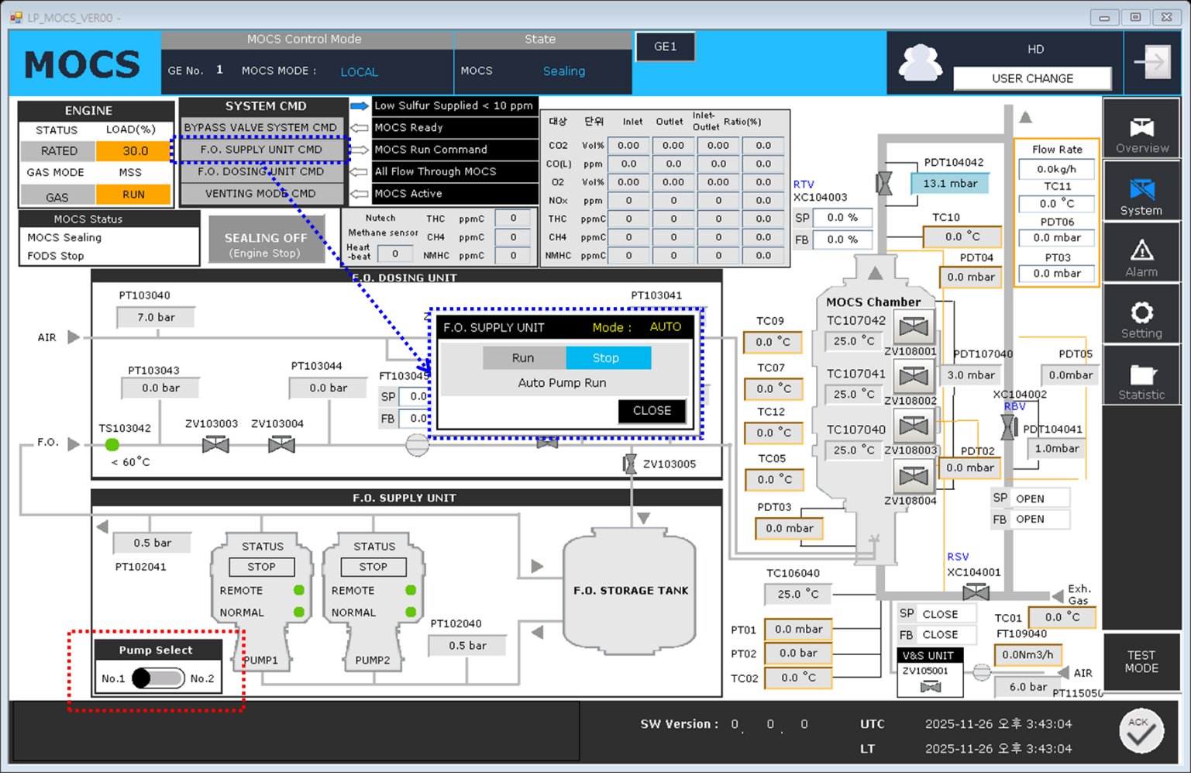
S-trap은 메인 화면에서 항상 표시
퍼센티지 표시는 1% 단위로, 소수점 첫번째 자리에서 반올림
나머지 시간은 별도의 페이지로
1-1. S-trap Life Time Gauge
(메인 화면)
50~100 % : 초록색
20~50 %: 주황색
0~20%: 빨간색
S-trap Lifetime
S-trap Lifetime
99%
5%
S-trap Lifetime
S-trap Lifetime
30%
0%
S-trap Lifetime
99%

Slide 2
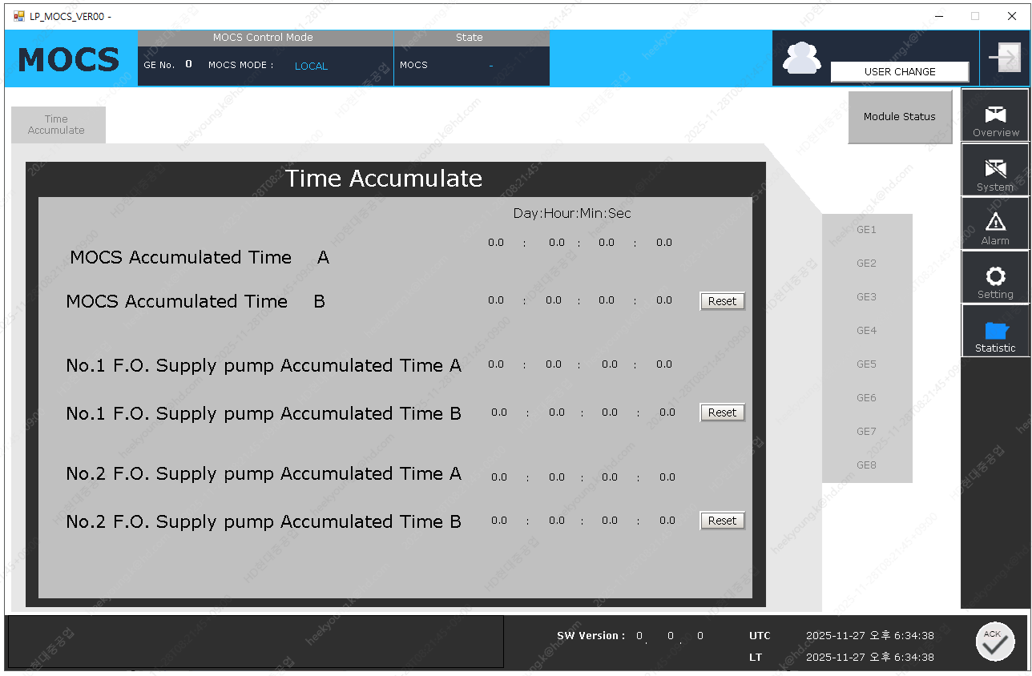
S-trap은 메인 화면에서 항상 표시
퍼센티지 표시는 1% 단위로, 소수점 첫번째 자리에서 반올림
나머지 시간은 별도의 페이지로
MOCS Time Counter
1-1. S-trap Life Time Gauge
MOCS Total Operating Time
12,500 hr
50~100 % : 초록색
20~50 %: 주황색
0~20%: 빨간색
MOC Operating Time
2,000 hr
RESET
Replace the downstream catalyst every 8,000 hours
S-trap Lifetime
90%
RESET
Replace the upstream catalyst when lifetime reaches 0%
F.O Supply Pump Total Operating Time
12,474 hr
No.1 Pump Operating Time
2,000 hr
RESET
No.2 Pump Operating Time
2,000 hr
RESET

Slide 3
MOCS Time Counter
1-1. S-trap Life Time Gauge
MOCS Total Operating Time
12,500 hr
50~100 % : 초록색
20~50 %: 주황색
0~20%: 빨간색
MOC Operating Time
2,000 hr
RESET
Replace the downstream catalyst every 8,000 hours
S-trap Lifetime
40%
RESET
Replace the upstream catalyst when lifetime reaches 0%
F.O Supply Pump Total Operating Time
12,474 hr
No.1 Pump Operating Time
2,000 hr
RESET
No.2 Pump Operating Time
2,000 hr
RESET

Slide 4
MOCS Time Counter
1-1. S-trap Life Time Gauge
MOCS Total Operating Time
12,500 hr
50~100 % : 초록색
20~50 %: 주황색
0~20%: 빨간색
MOC Operating Time
2,000 hr
RESET
Replace the downstream catalyst every 8,000 hours
S-trap Lifetime
10%
RESET
Replace the upstream catalyst when lifetime reaches 0%
F.O Supply Pump Total Operating Time
12,474 hr
No.1 Pump Operating Time
2,000 hr
RESET
No.2 Pump Operating Time
2,000 hr
RESET

Slide 5
MOCS Time Counter
1-1. S-trap Life Time Gauge
MOCS Total Operating Time
12,500 hr
50~100 % : 초록색
20~50 %: 주황색
0~20%: 빨간색
MOC Operating Time
2,000 hr
RESET
Replace the downstream catalyst every 8,000 hours
S-trap Lifetime
0%
RESET
0%에서 사용 시
게이지 상자 및 교체 문구
빨간색으로 점멸
Replace the upstream catalyst when lifetime reaches 0%
F.O Supply Pump Total Operating Time
12,474 hr
No.1 Pump Operating Time
2,000 hr
RESET
No.2 Pump Operating Time
2,000 hr
RESET

Slide 6
MOCS Time Counter
2-1. MOC, S-trap Reset
MOCS Total Operating Time
12,500 hr
MOC Operating Time
2,000 hr
RESET
MOC RESET 버튼 클릭 시, 팝업창
Replace Catalyst Layer 1 at 8,000 hours
Are you sure
you want to reset the time?
Please ensure the second layer catalyst(MOC) inside the chamber has been replaced before proceeding.
S-trap Life Time
0%
RESET
Replace Catalyst Layer 2 at 0%
F.O Supply Pump
Total Operating Time
12,474 hr
S-trap RESET 버튼 클릭 시, 문구
Are you sure
you want to reset the gauge?
Please ensure the first layer catalyst(S-trap) inside the chamber has been replaced before proceeding.
No.1 Pump Operating Time
2,000 hr
RESET
YES
NO
No.2 Pump Operating Time
2,000 hr
RESET

Slide 7

MOCS Time Counter
2-2. MOC, S-trap Reset
MOCS Total Operating Time
12,500 hr
WARNING
MOC Operating Time
2,000 hr
RESET
MOC RESET ‘YES’ 버튼 클릭 시, 팝업 창
Replace Catalyst Layer 1 at 8,000 hours
Do you still want to proceed?
Once the time is reset, it cannot be undone. If the catalyst has NOT been replaced, MOCS performance prediction may be inaccurate.
S-trap Life Time
0%
RESET
Replace Catalyst Layer 2 at 0%
S-trap RESET ‘YES’ 버튼 클릭 시, 문구
Do you still want to proceed?
Once the gauge is reset, it cannot be undone. If the catalyst has NOT been replaced, MOCS performance prediction may be inaccurate.
F.O Supply Pump
Total Operating Time
12,474 hr
No.1 Pump Operating Time
2,000 hr
RESET
PROCEED
CANCEL
No.2 Pump Operating Time
2,000 hr
RESET

Slide 8
MOCS Time Counter
3-1. Pump Time Reset
MOCS Total Operating Time
12,500 hr
MOC Operating Time
2,000 hr
RESET
No. 1 Pump RESET 버튼 클릭 시, 팝업창
Replace the downstream catalyst every 8,000 hours
Are you sure
you want to reset the time?
Please ensure the No.1 Pump inside the F.O Supply pump has been replaced before proceeding.
S-trap Lifetime
90%
RESET
Replace the upstream catalyst when lifetime reaches 0%
F.O Supply Pump Total Operating Time
No. 2 Pump RESET 버튼 클릭 시, 문구
Are you sure
you want to reset the gauge?
Please ensure the No.2 Pump inside the F.O Supply pump has been replaced before proceeding.
12,474 hr
No.1 Pump Operating Time
2,000 hr
RESET
YES
NO
No.2 Pump Operating Time
2,000 hr
RESET

Slide 9
MOCS Time Counter
3-2. Pump Time Reset
MOCS Total Operating Time
12,500 hr
WARNING
MOC Operating Time
2,000 hr
RESET
RESET ‘YES’ 버튼 클릭 시, 팝업 창
Replace the downstream catalyst every 8,000 hours
Do you still want to proceed?
Once the time is reset, it cannot be undone. If the pump has NOT been replaced, MOCS performance prediction may be inaccurate.
S-trap Lifetime
90%
RESET
Replace the upstream catalyst when lifetime reaches 0%
F.O Supply Pump Total Operating Time
12,474 hr
No.1 Pump Operating Time
2,000 hr
RESET
PROCEED
CANCEL
No.2 Pump Operating Time
2,000 hr
RESET

Slide 10
MOCS 총 운전시간
MOC 운전 시간 + RESET
S-trap 운전 시간 + RESET
Pump ½ 총 운전 시간
Pump ½ 운전시간 + RESET
MOCS Time Counter
Total Operating Time
00 : 00 : 00
Hr. Min. Sec.
MOC Operating Time
S-trap Service Life
00 : 00 : 00
Hr. Min. Sec.
Sulfur Accumulation
60%
RESET
Fuel Oil Supply Pump Total Operating Time
00 : 00 : 00
Hr. Min. Sec.
No.1 Pump Operating Time
No.2 Pump Operating Time
00 : 00 : 00
Hr. Min. Sec.
00 : 00 : 00
Hr. Min. Sec.
RESET
RESET

